Slide 1




Generative models
Variational AE and flows
Master ATIAM
Philippe Esling (esling@ircam.fr)
Maître de conférences – Sorbonne Université
Equipe représentations musicales (IRCAM, Paris)

Slide 2


Variational inference
We take back our inference problem
prior
posterior
likelihood
Could we transform this integral
Using a simpler and tractable distribution ?

Slide 3
Variational inference
Starting from our intractable integral
The goal of Variational Inference is to approximate this by using optimization instead of derivation.
Select a family of parametric distributions
Optimize the parameters in order to solve

Slide 4
Modeling the joint probability
Introducing
Jensen’s inequality

Slide 5

Auto-encoding
« Latent » code
Very limited model because
Defines a deterministic mapping
No robust theoretical properties on the latent code ( almost decorative)
Very limited generalization abilities (does not model )
How can we model the intractable
Introducing variational inference ☺

Slide 6
Variational auto-encoders
We want to minimize approximation error
Encode a sound using to find the mean and variance in the space
Sample from this gaussian distribution to obtain
Decode the corresponding position using
[Kingma, D. P., & Welling, M. (2014). Auto-Encoding Variational Bayes. ICLR 2015, 1050, 1.]

Slide 7
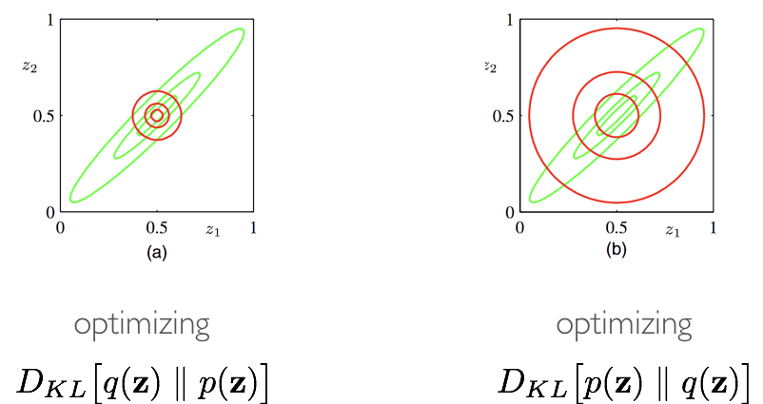
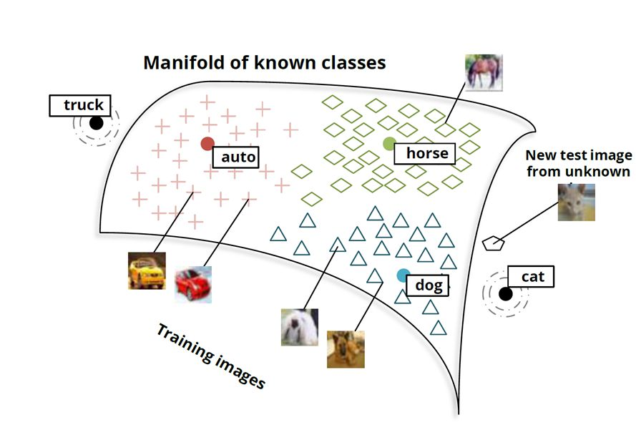
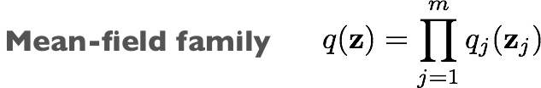
Variational auto-encoders
[Kingma, D. P., & Welling, M. (2014). Auto-Encoding Variational Bayes. ICLR 2015, 1050, 1.]

Slide 8
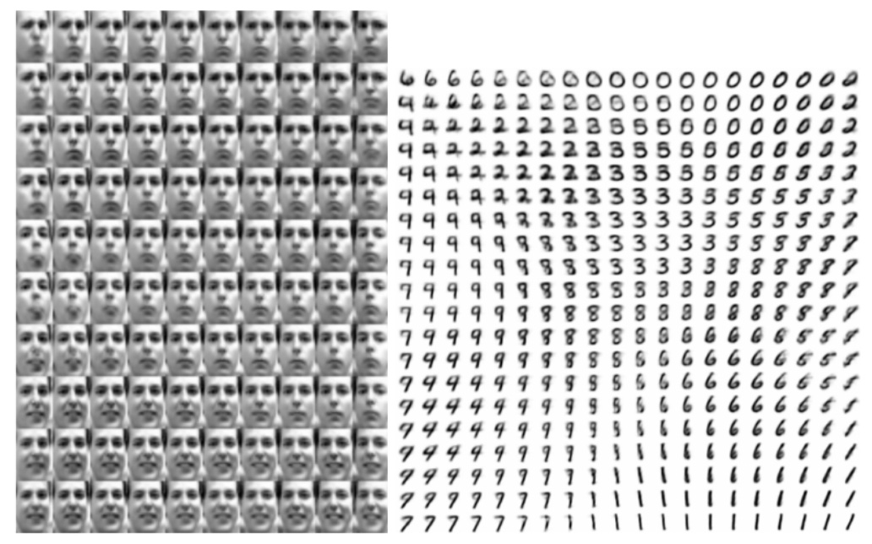
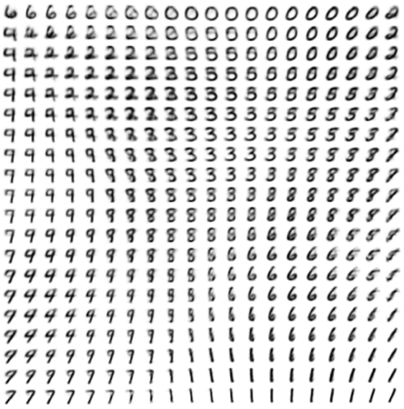
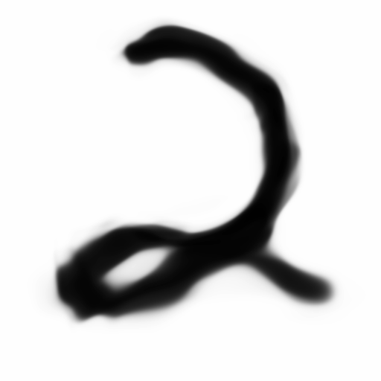
Variational auto-encoders
[Kingma, D. P., & Welling, M. (2014). Auto-Encoding Variational Bayes. ICLR 2015, 1050, 1.]

Slide 9
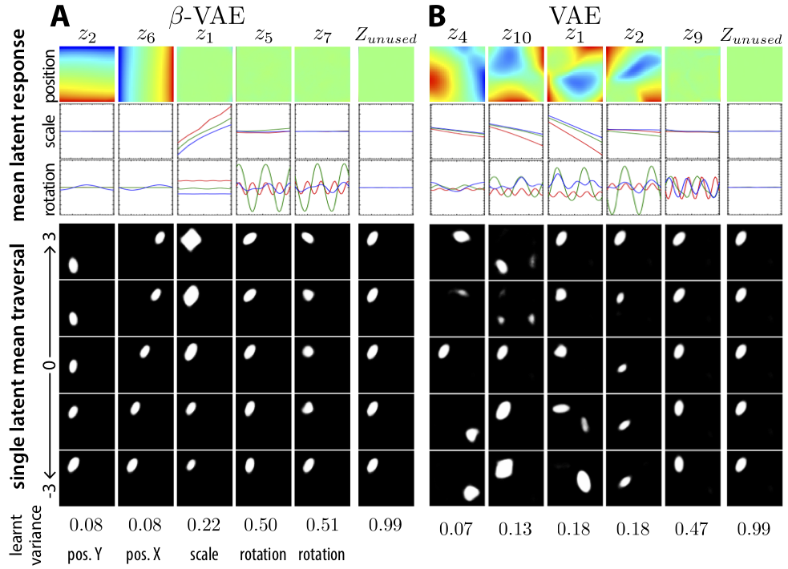
Unsupervised disentanglement with VAE
Find the underlying factors of variation in data
Higgins, I., Matthey, L., Pal, A., Burgess, C., Glorot, X., Botvinick, M., ... & Lerchner, A. (2016). beta-vae: Learning basic visual concepts with a constrained variational framework.

Slide 10
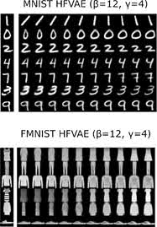
Unsupervised disentanglement with VAE
More disentanglement
Vector-Quantized VAE
Razavi, A., van den Oord, A., & Vinyals, O. (2019). Generating diverse high-fidelity images with vq-vae-2. In Advances in Neural Information Processing Systems (pp. 14866-14876).

Slide 11
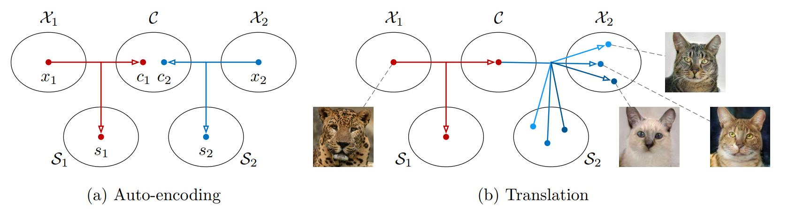
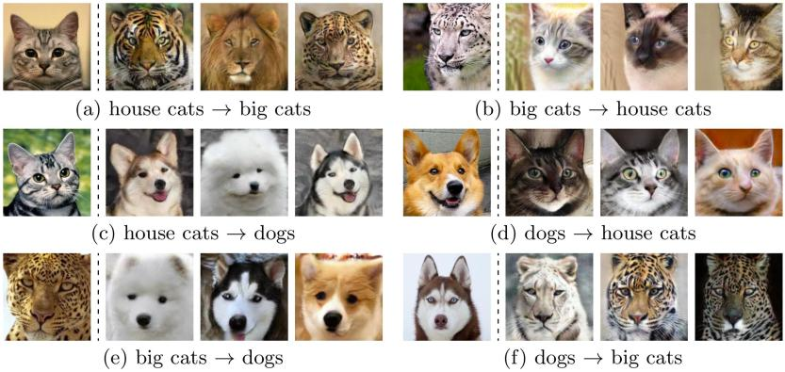
Unsupervised image transfer with VAE
Huang, X., Liu, M. Y., Belongie, S., & Kautz, J. (2018). Multimodal unsupervised image-to-image translation. In Proceedings of the European Conference on Computer Vision (ECCV) (pp. 172-189).

Slide 12
Normalizing flows
Probabilistic inference mostly deal with simple distributions
Provide easier analytical solutions
Implicit assumption of a simple explanation (capacity)
Too simplistic assumption in most cases
Real data follows largely more complex distributions
These distributions are usually intractable
The almighty Gaussian
Real data ?
How to use complex distributions but keep analytical simplicity ?
Given a random variable
we can transform it to obtain
?
We want this to be a distribution
Only need it to sum (integrate) to 1 !
Change of volume is given by the determinant of the Jacobian
So in fact we can use any transform, but with a simple determinant of Jacobian
Given
Planar flow proposed in the original paper
We have
[Danilo Rezende and Shakir Mohamed, “Variational inference with normalizing flows,” ICML Conference, 2015]

Slide 13
Normalizing flows
Now we know how to transform
If we chain these transforms, so that
…
We obtain the final distribution simply by reapplying the same reasoning
Learn increasingly complex distributions
Just applying simple invertible transforms
Of course it holds for multiple dimensions
4 flows
[Danilo Rezende and Shakir Mohamed, “Variational inference with normalizing flows,” ICML Conference, 2015]
We can obtain an arbitrarily complex distribution given by

Slide 14
Variational Auto-Encoders (VAE)
A (very brief) recap on Variational Auto-Encoders (VAE)
Corresponding graphical model
Use Gaussian prior for analytical simplicity
Too simplistic for real data distributions
Postulate variational approximation
We want to minimize approximation error
Encode the input using to find the mean and variance
Sample from this gaussian distribution to obtain
Decode the corresponding position using
[Derdrik P. Kingma and Max Welling “Auto-encoding variational Bayes” ICML Conference, 2014]

Slide 15
Normalizing flows in variational inference
Alleviate this limitation and model more complex distributions
Corresponding graphical model
Decode and generate from much more complex distribution
Still regularize with Gaussian
Complexify with normalizing flows
Introduce normalizing flow in the optimization objective
Still regularize on a simple prior
(Analytical Gaussian simplicity)
Decode from the complex distribution
Ensure that all latent are distributions (normalizing flow)
We want to minimize approximation error
[Kingma, D. P., & Welling, M. (2014). Auto-Encoding Variational Bayes. ICLR 2015, 1050, 1.]

Slide 16
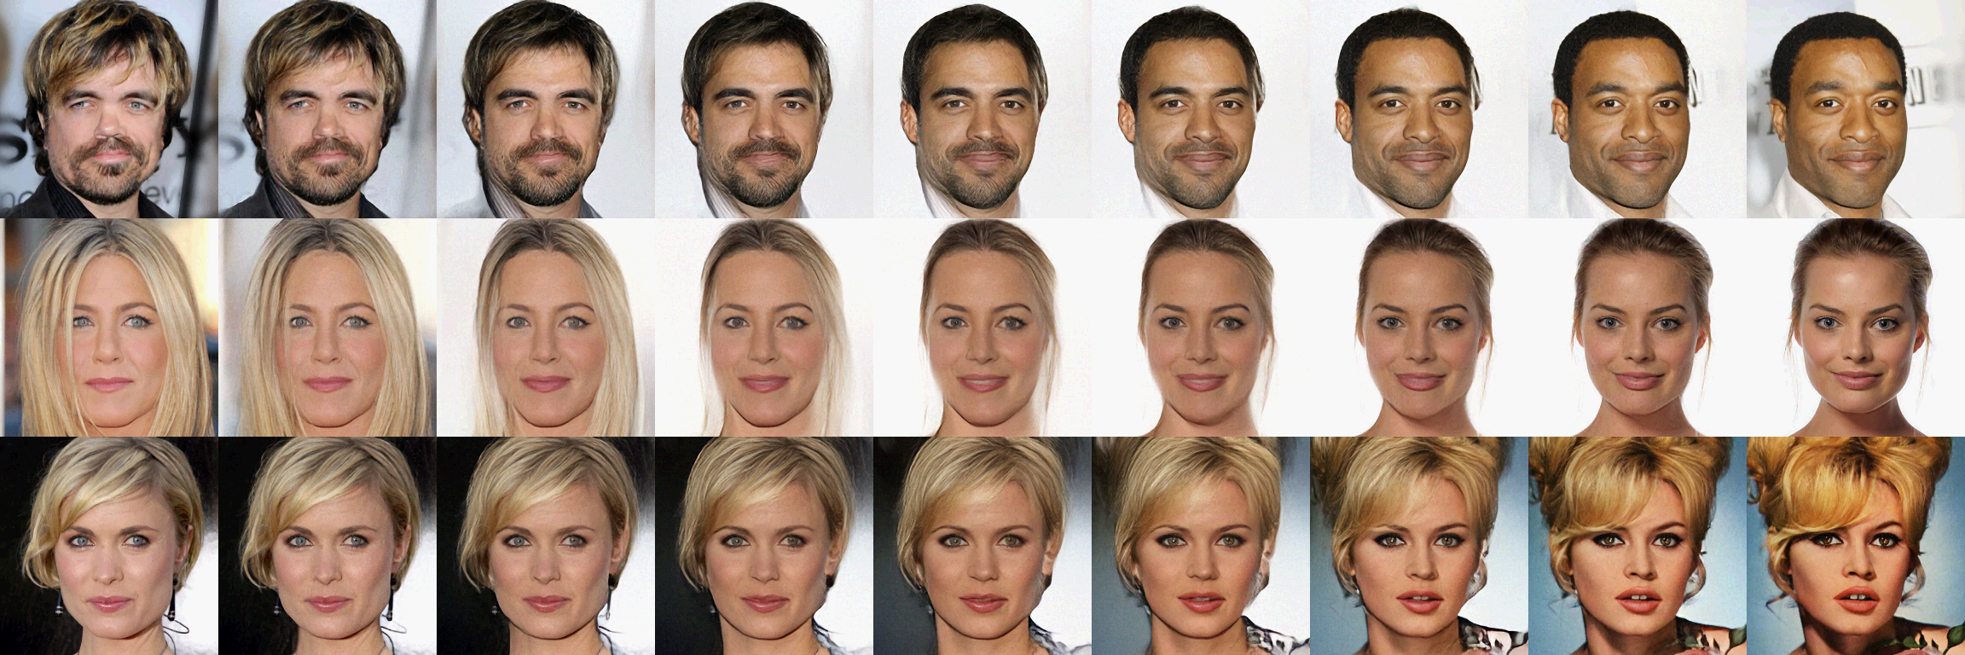
Generative flows (GLOW)
Still regularize on a simple prior
(Analytical Gaussian simplicity)
Decode from the complex distribution
Ensure that all latent are distributions (normalizing flow)
Kingma, D. P., & Dhariwal, P. (2018). Glow: Generative flow with invertible 1x1 convolutions. In Advances in neural information processing systems (pp. 10215-10224).
We want to minimize approximation error
[Kingma, D. P., & Welling, M. (2014). Auto-Encoding Variational Bayes. ICLR 2015, 1050, 1.]

